Slide 1


Single-Cell Omics:
Integrative Processing of scRNA-seq and scProteomic Data
1

Slide 2
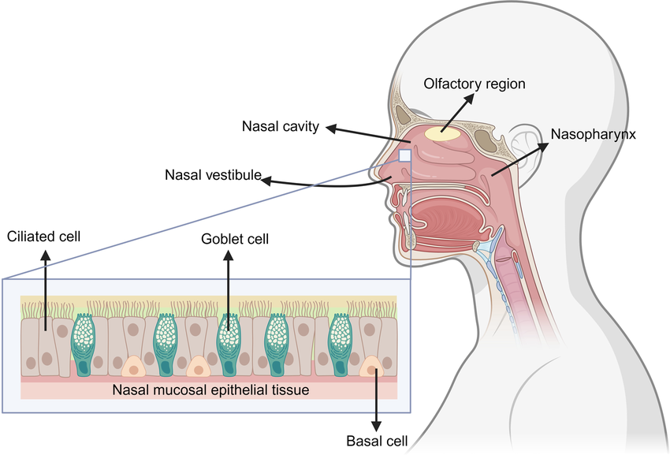
Nasal mucosa and Hcov-229E infection
2

Slide 3
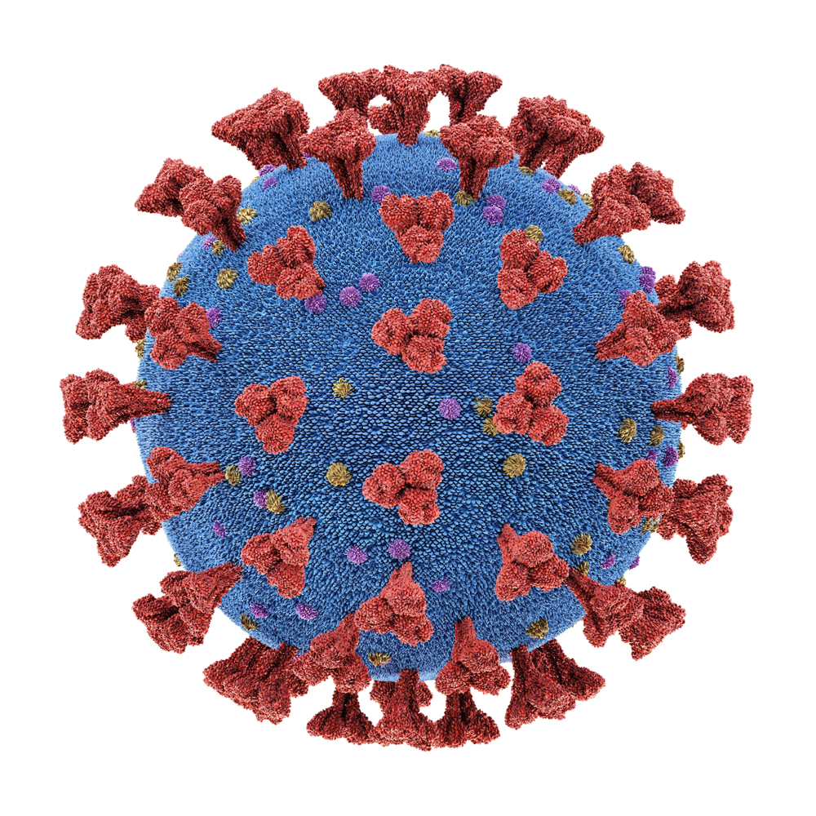
Nasal mucosa and Hcov-229E infection
Hcov-229E
?
?
3

Slide 4
Bulk vs single cell analysis
Mock
Inf
No information between cell types
Goblet cells
Goblet cells
Bulk
???
Basal cells
Basal cells
Ciliated cells
Ciliated cells
4

Slide 5
Bulk vs single cell analysis
Mock
Highlight the specific differences between cell types
Inf
Goblet cells
Goblet cells
Basal cells
Basal cells
Ciliated cells
Ciliated cells
5

Slide 6
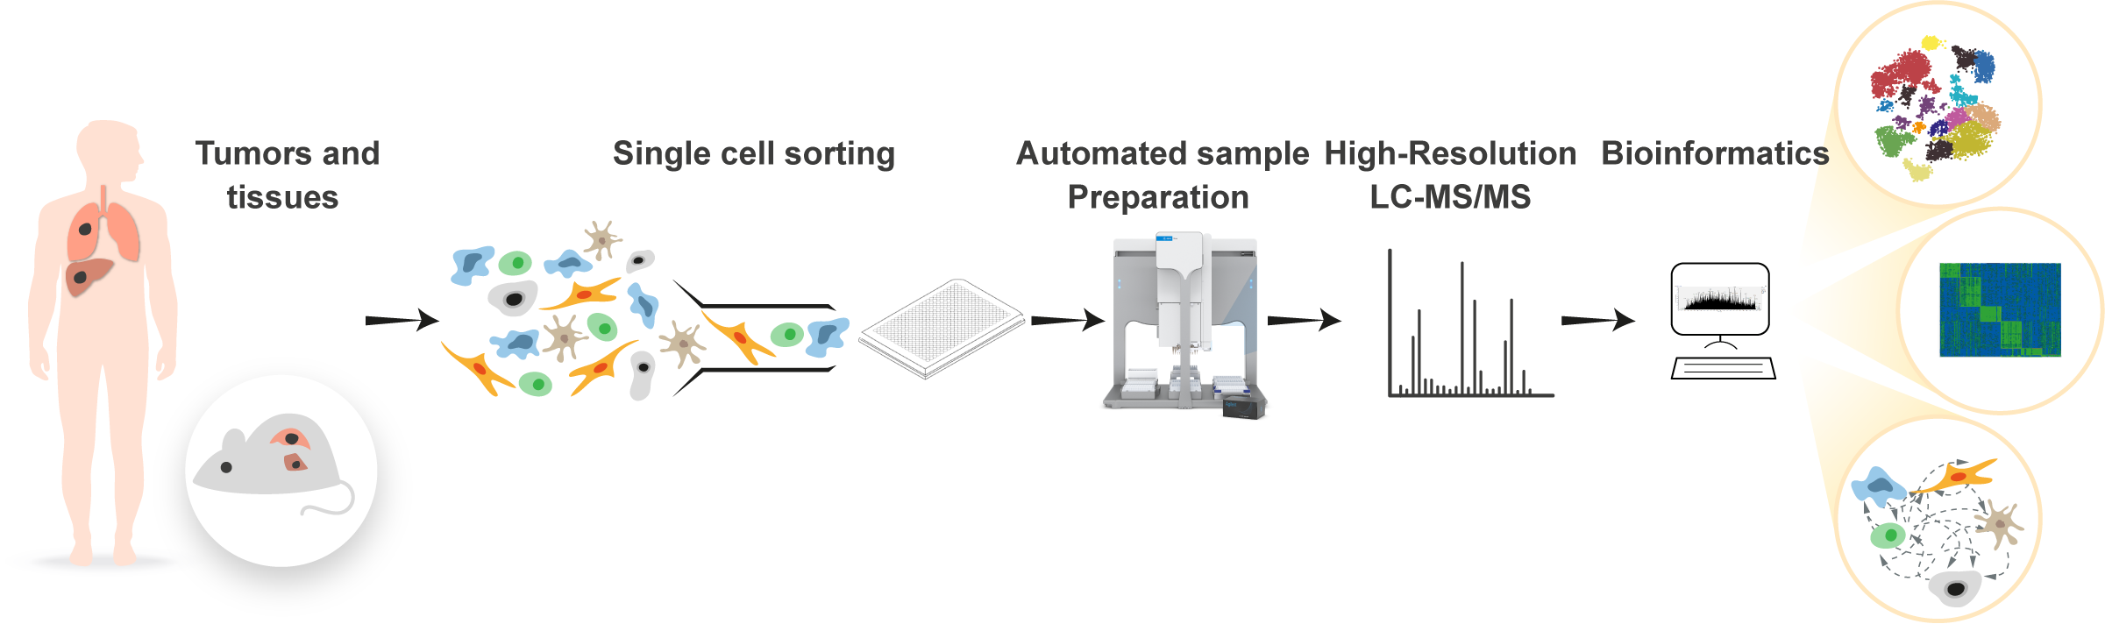
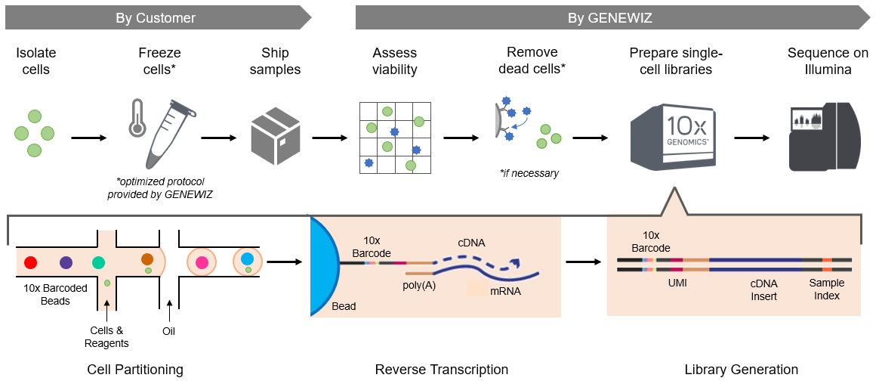
Single cell workflows
Proteomic
RNA seq
6
Notes:
https://web.genewiz.com/single-cell-faq
https://www.weizmann.ac.il/mcb/TGeiger/research-activities/single-cell-proteomic

Slide 7
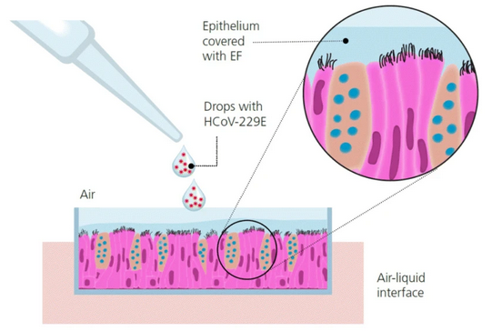
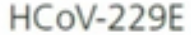
Gaia experiment
Inf
sc RNA workflow
dpi : 6 days
sc Proteomic workflow
Mock
dpi : 3 days
sc RNA workflow
sc Proteomic workflow
7
Notes:
https://virologyj.biomedcentral.com/articles/10.1186/s12985-020-01401-2/figures/3

Slide 8
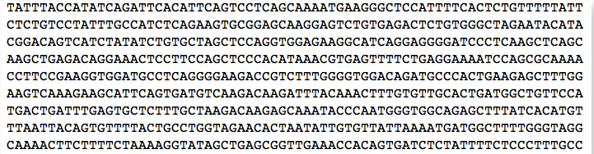

Sc RNA seq
8

Slide 9
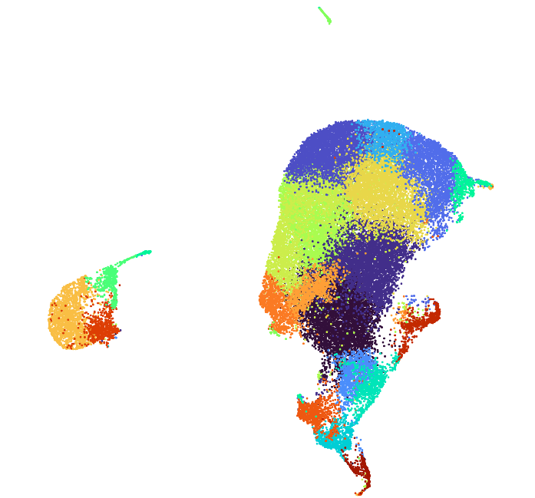
UMAPs generated with the transcriptomic dataset
21 clusters
All samples by 10X Genomics
9

Slide 10
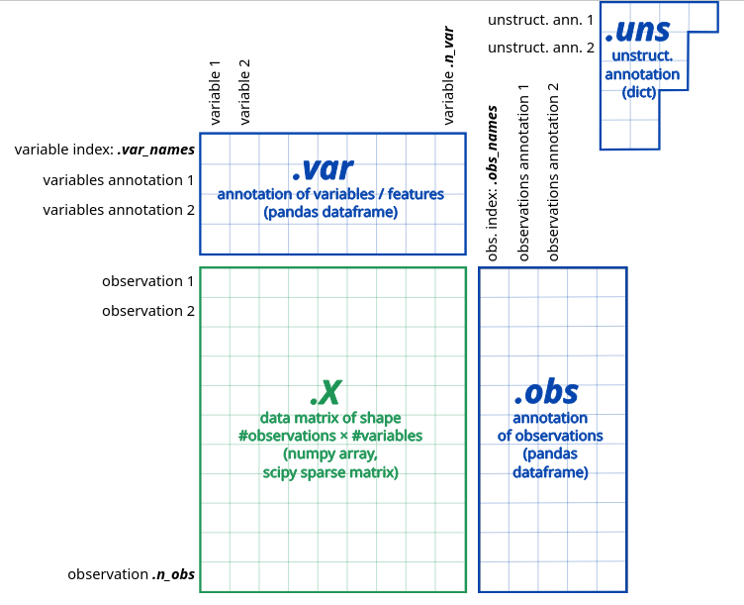
Data Frame of the scRNA
Genes
Cells
10

Slide 11
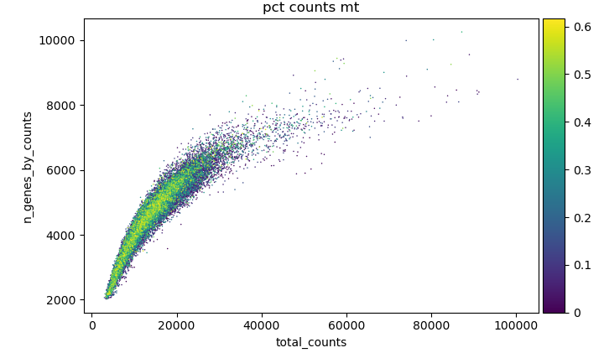
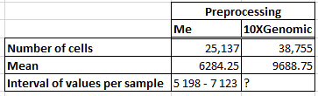
Preprocessing scRNA Data
Remove outliers
mad_outliers
AnnData object with n_obs × n_vars = 9137 × 18087
AnnData object with n_obs × n_vars = 10542 × 18087
AnnData object with n_obs × n_vars = 8525 × 18087
AnnData object with n_obs × n_vars = 11004 × 18087
AnnData object with n_obs × n_vars = 9128 × 18087
AnnData object with n_obs × n_vars = 10542 × 18087
AnnData object with n_obs × n_vars = 8525 × 18087
AnnData object with n_obs × n_vars = 10997 × 18087
Filtered data from cellbender
QC labelling
Preprocessed data
- label MT, ribo and Hb genes
- cells >200 genes
View of AnnData object with n_obs × n_vars = 6007 × 18087
View of AnnData object with n_obs × n_vars = 6753 × 18087
View of AnnData object with n_obs × n_vars = 5398 × 18087
View of AnnData object with n_obs × n_vars = 7142 × 18087
End of preprocessing :
scDblFinder
Score and doublet detection
11
Plot of the cells distribution
N of reads
Notes:
Mad = median with a x standard deviation

Slide 12
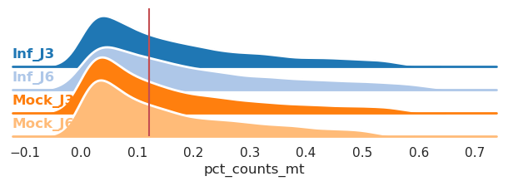
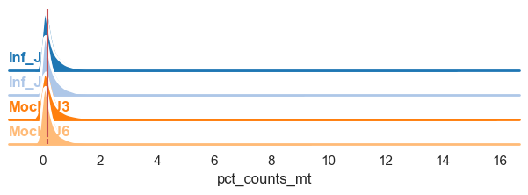
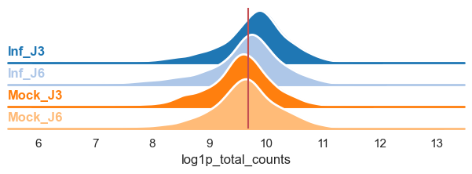
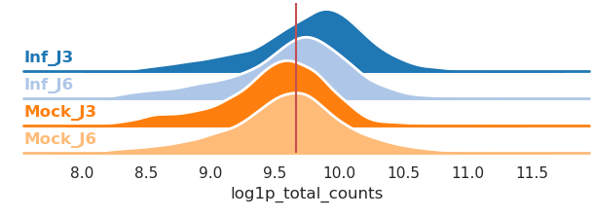
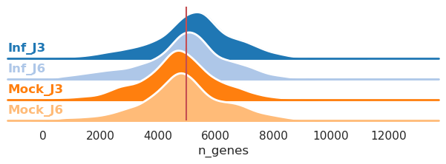
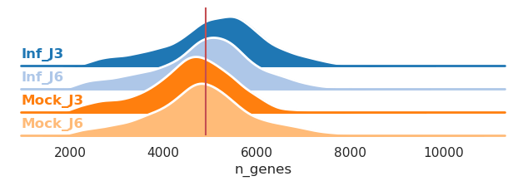
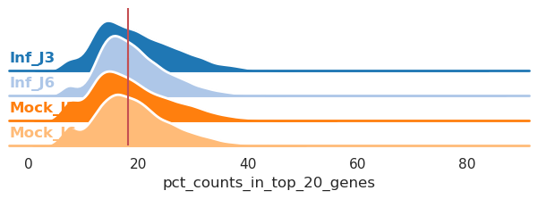
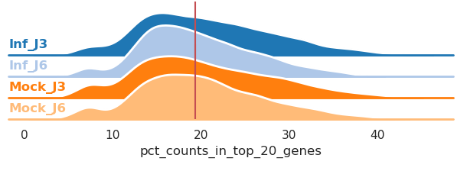
Pre-processing
Removed outliers, doublets, dead cells and non cell RNA
12

Slide 13
Processing of the scRNA data
Celltypist
Data X_test
Prediction using :
- Human_Lung_Atlas
- Cells_Lung_Airway
Preprocessed data
Data & predictions
Separation of X count matrix
[2.]
Preprocessed data
ScVI label transfering
Labels transfert from query to adata
Data with X_train & predictions
Integrated data
Annotation
Raw Query of healthy cells
~ 1.3 millions of cells
Keep only raw data of healthy cells
Integration using scVI
Query
~2.1 millions of cells
[1.]
1.Sikkema, L. et al. An integrated cell atlas of the lung in health and disease. Nat Med 29, 1563–1577 (2023).
13
2.Neufeld, A., Gao, L. L., Popp, J., Battle, A. & Witten, D. Inference after latent variable estimation for single-cell RNA sequencing data. Biostatistics 25, 270–287 (2023)

Slide 14
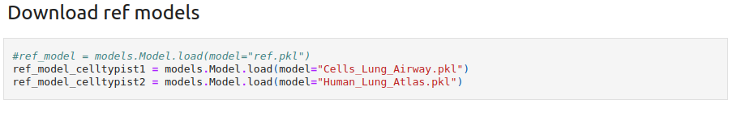
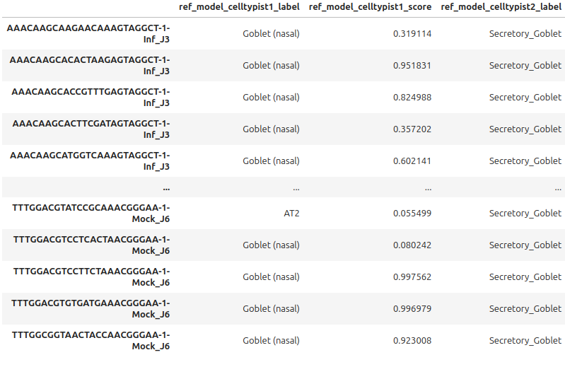
Celltypist
14

Slide 15
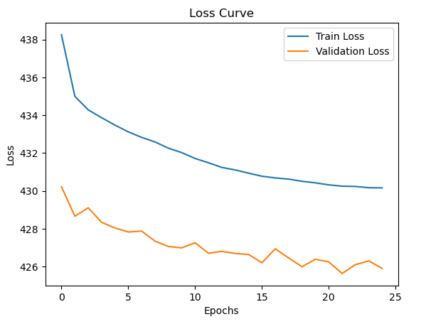
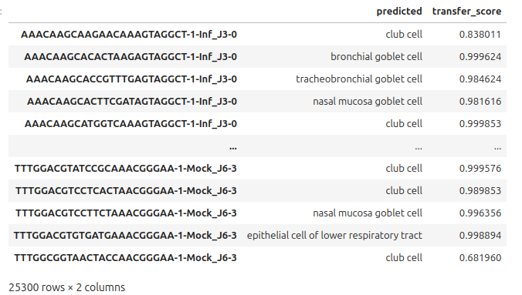
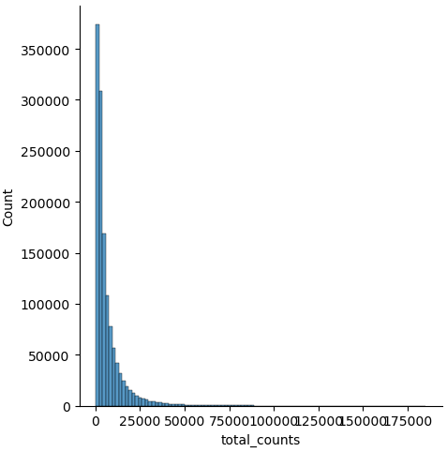
SCANVI and scVI labelling
Query preprocessing
(only the raw data from the healthy cells)
lvea model
Training the model
vae model
Preprocessed data
Raw data gene count
15

Slide 16
Processing of the scRNA data
Celltypist
Data X_test
Prediction using :
- Human_Lung_Atlas
- Cells_Lung_Airway
Preprocessed data
Data & predictions
Separation of X count matrix
[2.]
Preprocessed data
ScVI label transfering
Labels transfert from query to adata
Data with X_train & predictions
Integrated data
Annotation
Raw Query of healthy cells
~1.3 millions of cells
Keep only raw data of healthy cells
Integration using scVI
Query
[1.]
~2.1 millions of cells
1.Sikkema, L. et al. An integrated cell atlas of the lung in health and disease. Nat Med 29, 1563–1577 (2023).
16
2.Neufeld, A., Gao, L. L., Popp, J., Battle, A. & Witten, D. Inference after latent variable estimation for single-cell RNA sequencing data. Biostatistics 25, 270–287 (2023)

Slide 17
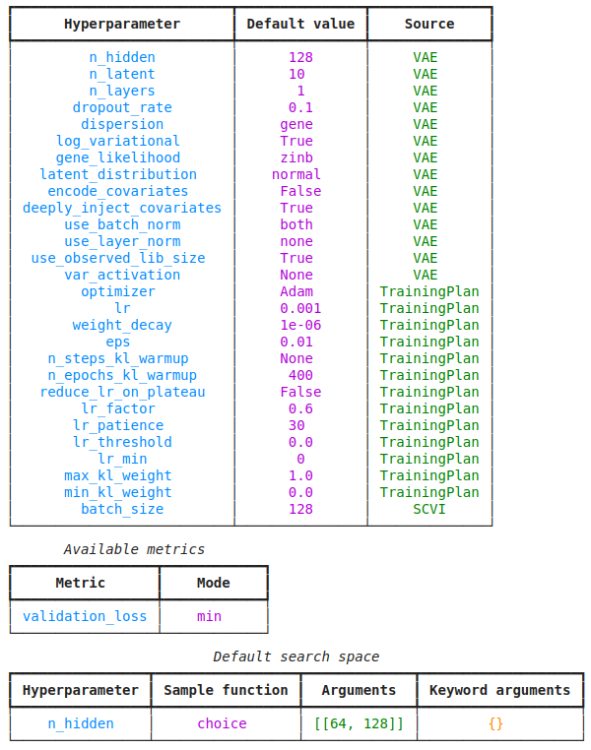
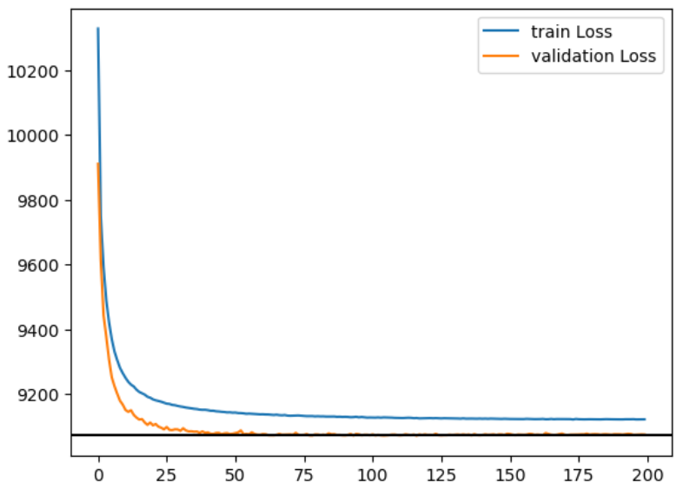
Integration using scVI
Hyperparameters
Processed data
Selection of the best hyperparameters
Model post fine tuning
Integrated data
(n_hidden=128,n_latent=40,n_layers=1, gene_likelihood = 'nb')
Processed data
Plot of train Loss and validation Loss
17

Slide 18
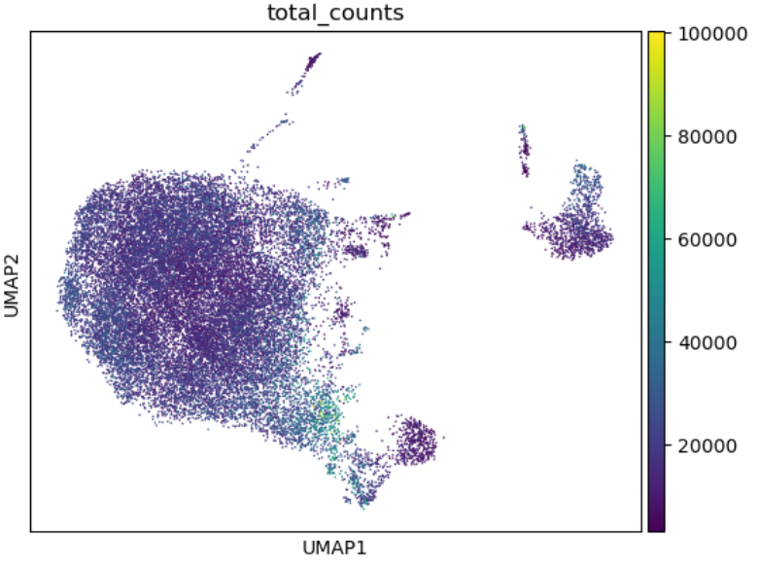
Mapping and annotations
DESeq2
Data X_test
Metacell count matrix creation with X_test
Differential expression of genes
[1.]
Gene marker analysis
Metacell creation using SEACell
SEACell
Integrated data with X_train
Normalised data with X_train
Annotated data
Normalization :
- log1 transform
Mapping using :
- adata.obsm['X_scVI'] = model.get_latent_representation()
- sc.pp.neighbors(adata, use_rep = 'X_scVI')
UMAPs generated using those processed datas...
18
1.Neufeld, A., Gao, L. L., Popp, J., Battle, A. & Witten, D. Inference after latent variable estimation for single-cell RNA sequencing data. Biostatistics 25, 270–287 (2023)

Slide 19
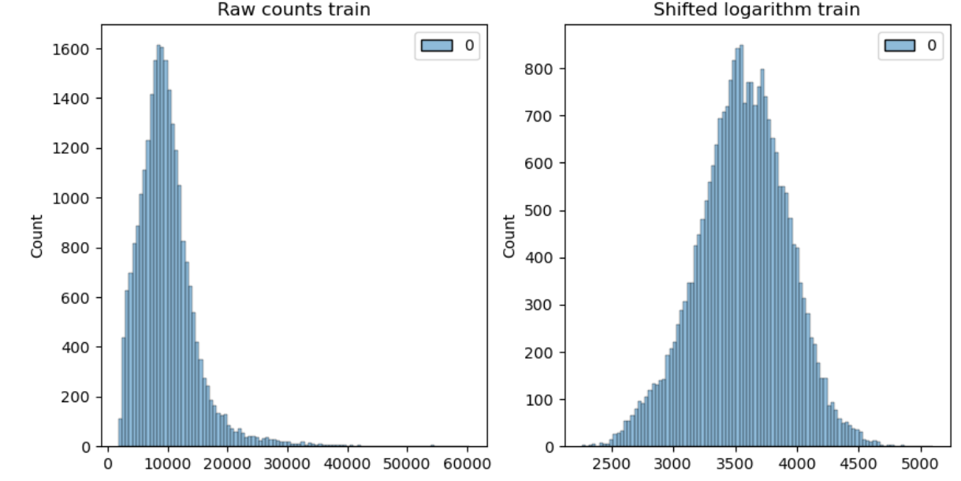
Normalisation of the datas
19

Slide 20
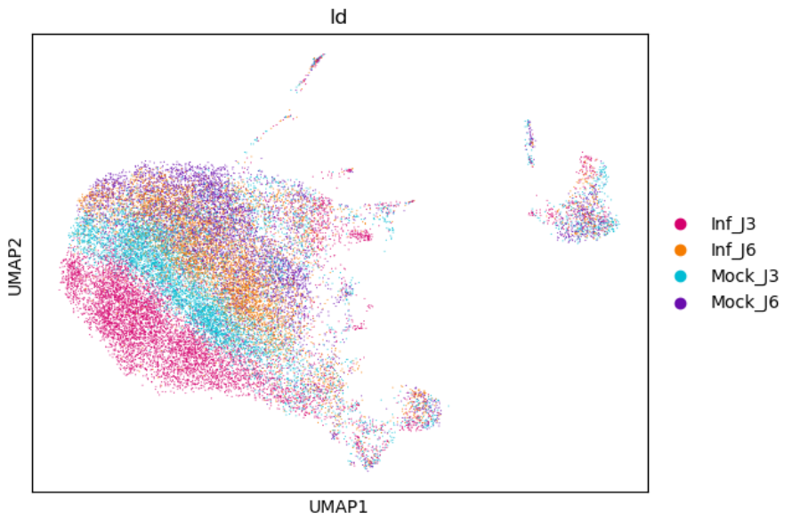
Mapping and annotations
20

Slide 21
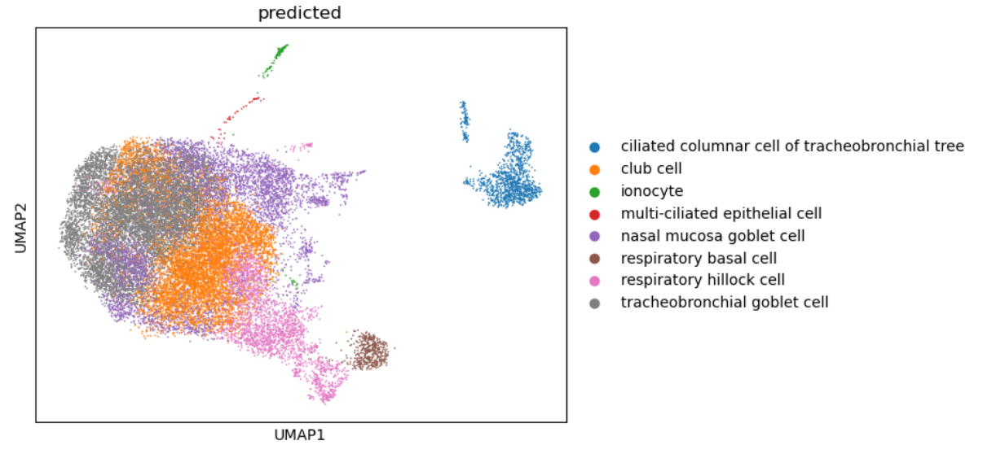
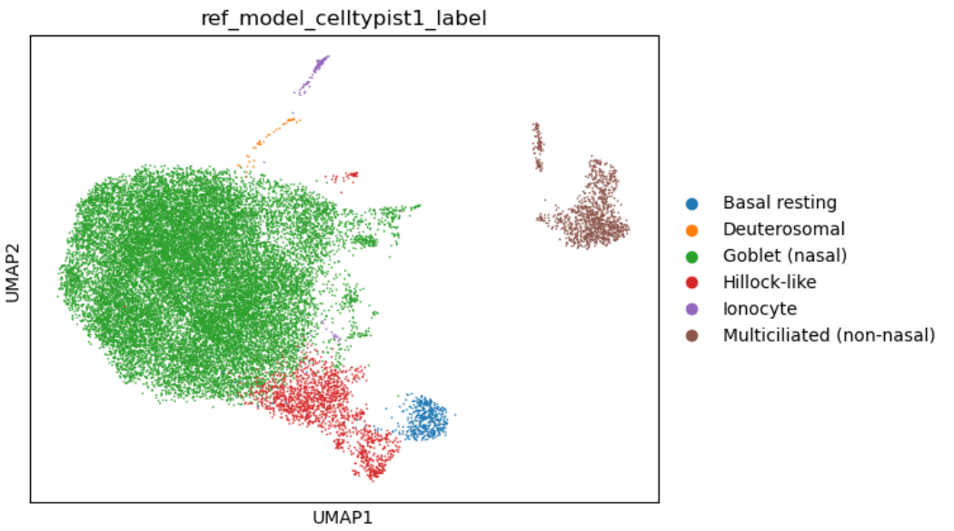
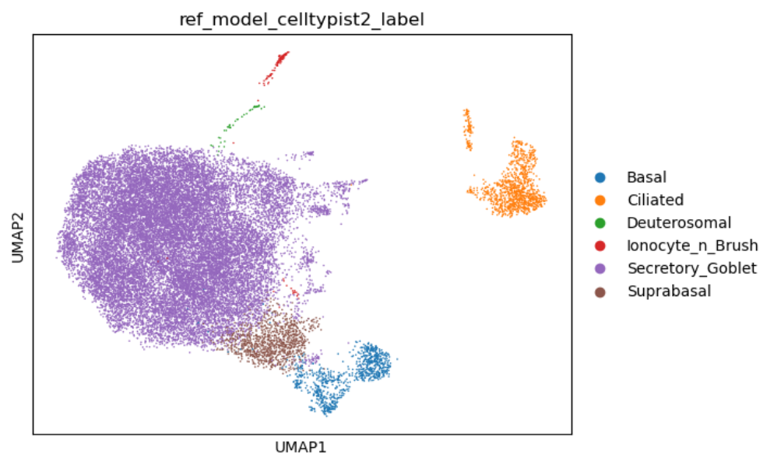
Mapping and annotations
21
21

Slide 22
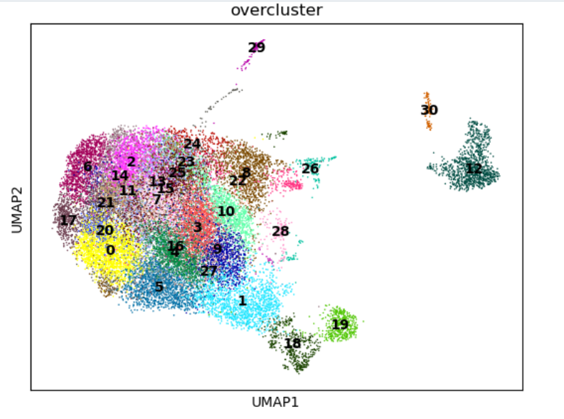
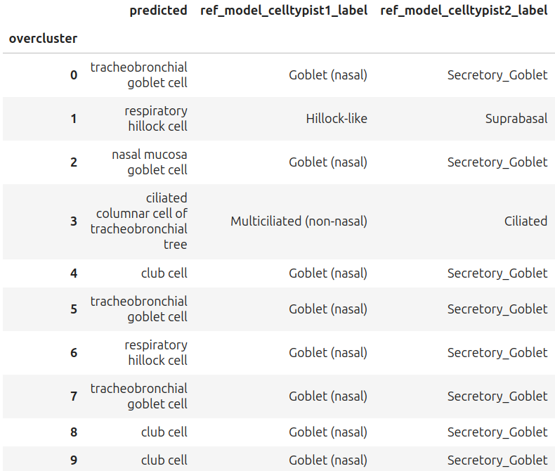
Mapping and annotations
...
49 overclusters for all samples
22

Slide 23
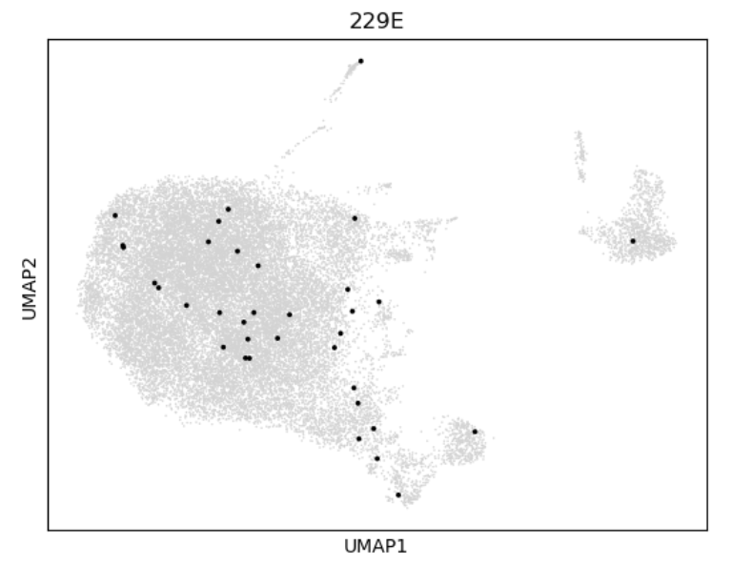
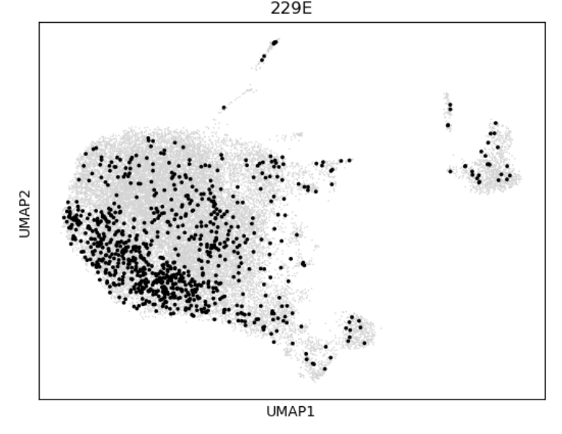
Hcov 229E
Mock pos
Inf pos
Hcov229E positive cells from Mock : 35
Hcov229E positive cells from Inf : 852
Cells with at least one of those genes : 887
23

Slide 24
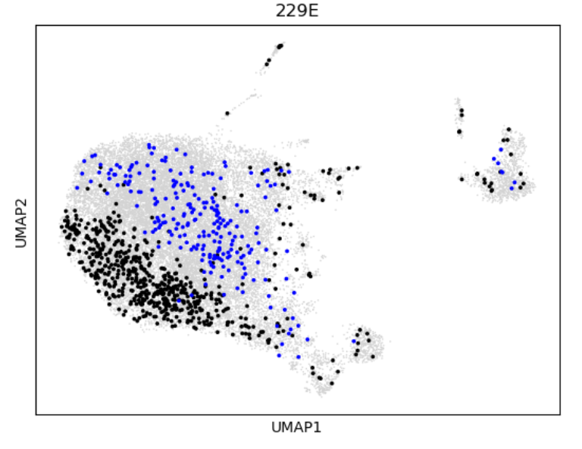
Hcov 229E
Blue : Inf_J6
Black : Inf_J3
Number of cells infected in Inf_J3 : 611
Number of cells infected in Inf_J6 : 241
24

Slide 25
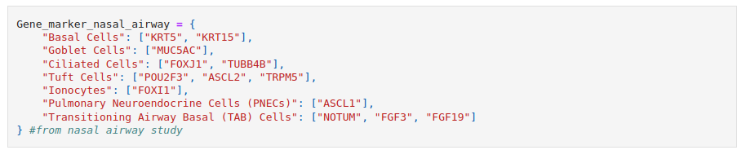
Gene marker analysis
DESeq2
Data X_test
Metacell count matrix creation with X_test
Differential expression of genes
Gene marker analysis
Metacell creation using SEACell
SEACell
Integrated data with X_train
Normalised data with X_train
Annotated data
Normalization :
- log1 transform
Verification using predictions & gene markers
Gene markers : (4 gene markers from 5 studies)
1.Lee, W. et al. A single-cell atlas of in vitro multiculture systems uncovers the in vivo lineage trajectory and cell state in the human lung. Exp Mol Med 55, 1831–1842 (2023).
2.Deprez, M. et al. A Single-Cell Atlas of the Human Healthy Airways. Am J Respir Crit Care Med 202, 1636–1645 (2020).
3.Sajuthi, S. P. et al. Nasal airway transcriptome-wide association study of asthma reveals genetically driven mucus pathobiology. Nat Commun 13, 1632 (2022).
4.Ha JG, Cho HJ. Unraveling the Role of Epithelial Cells in the Development of Chronic Rhinosinusitis. Int J Mol Sci. 2023 Sep 18;24(18):14229.
5.Martins, L.R., Sieverling, L., Michelhans, M. et al. Single-cell division tracing and transcriptomics reveal cell types and differentiation paths in the regenerating lung. Nat Commun 15, 2246 (2024). https://doi.org/10.1038/s41467-024-46469-4
25

Slide 26
Mapping and annotations
...
49 overclusters for all samples
26

Slide 27
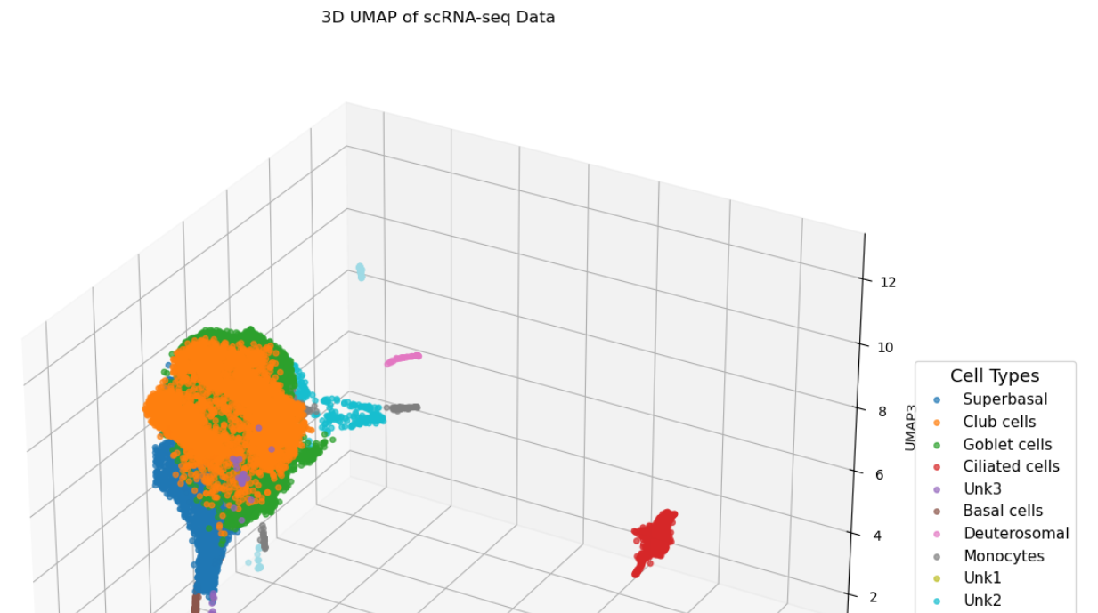
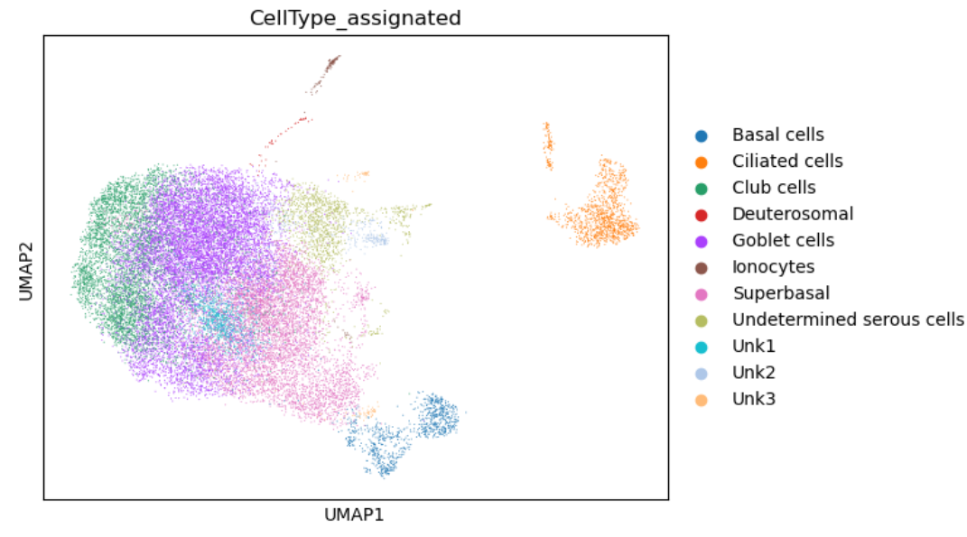
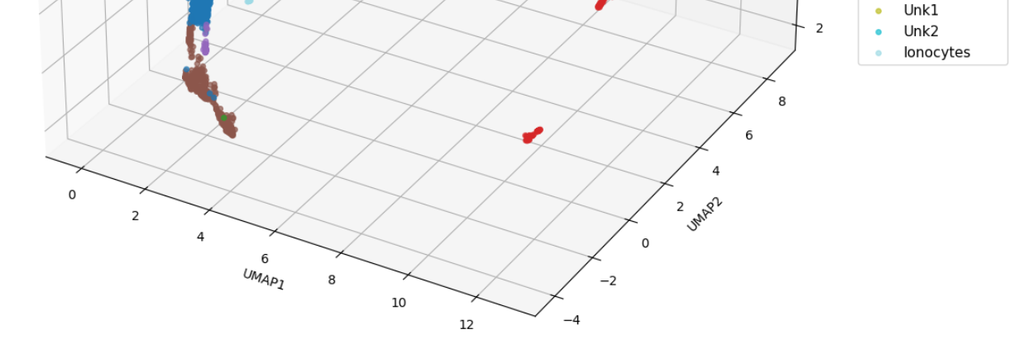
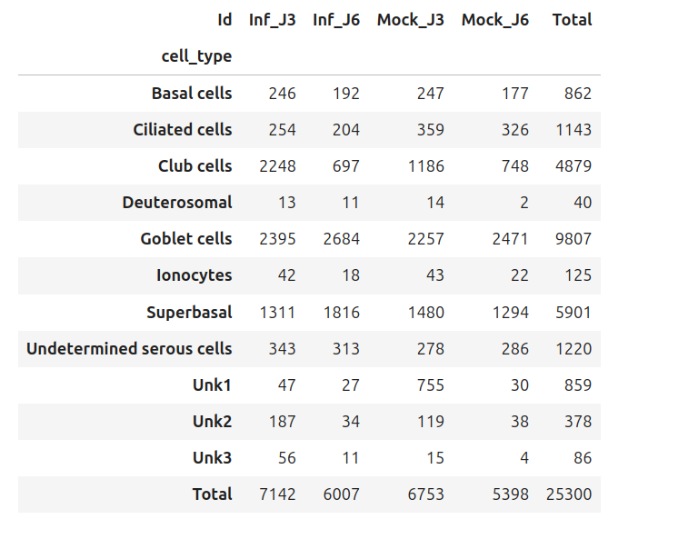
Annotation
27

Slide 28
Metacell formation
DESeq2
Data X_test
Metacell count matrix creation with X_test
Differential expression of genes
[1.]
Gene marker analysis
Metacell creation using SEACell
SEACell
Integrated data with X_train
Normalised data with X_train
Annotated data
Normalization :
- log1 transform
28
1.Neufeld, A., Gao, L. L., Popp, J., Battle, A. & Witten, D. Inference after latent variable estimation for single-cell RNA sequencing data. Biostatistics 25, 270–287 (2023)

Slide 29
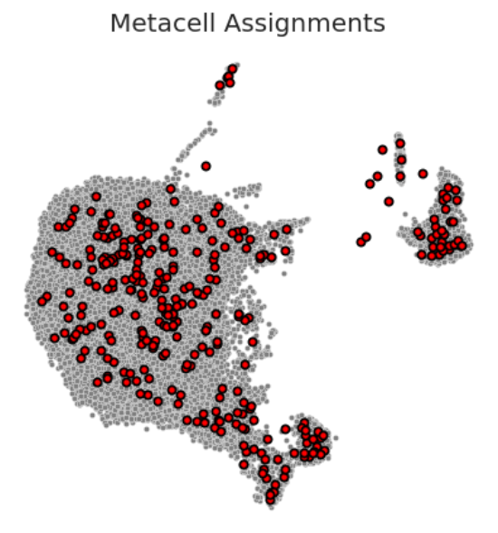
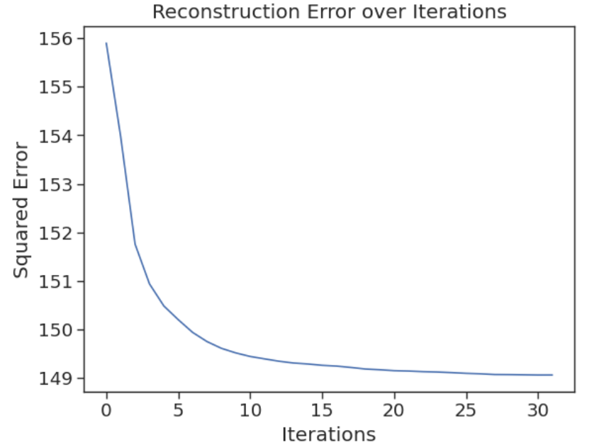
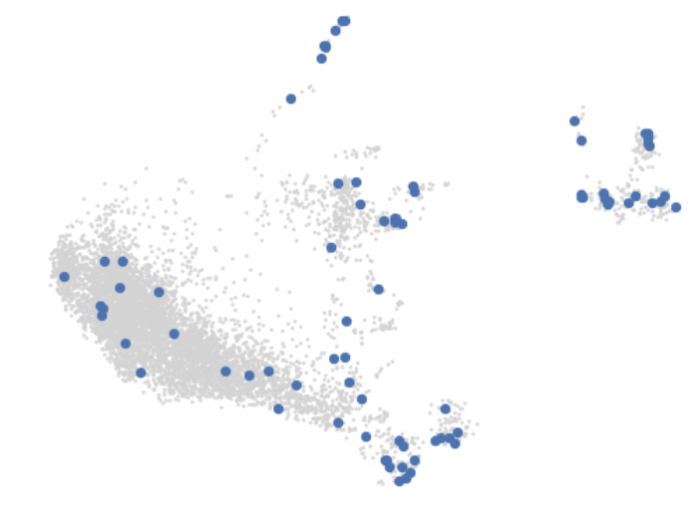
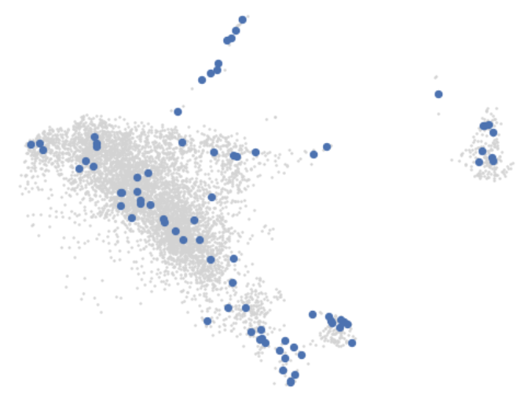
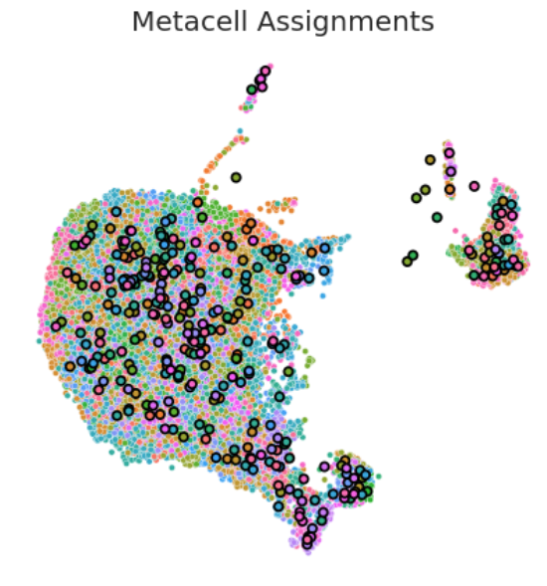
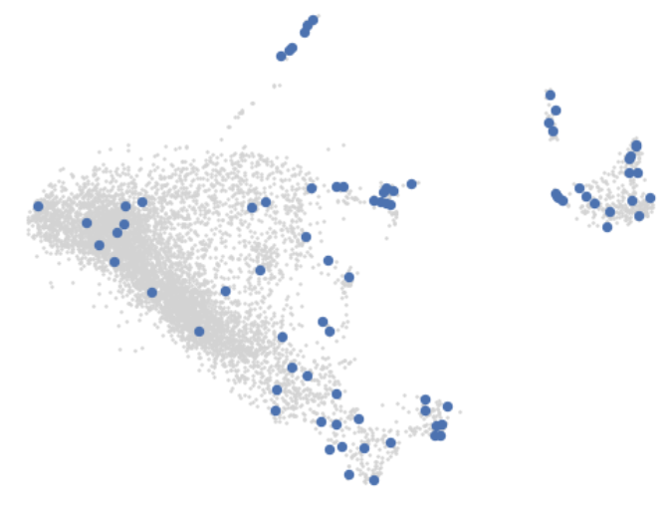
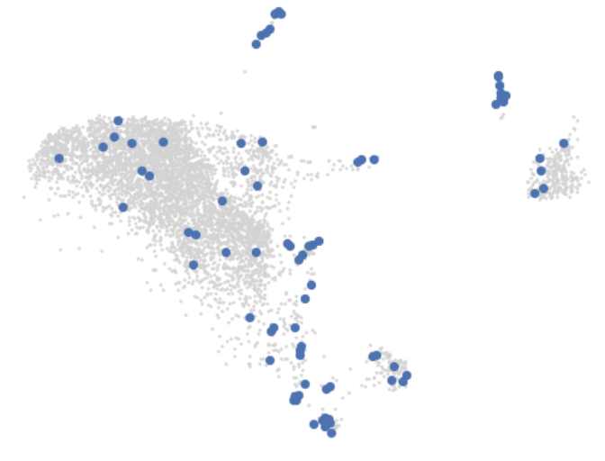
Metacell formation
Annotated data
SEACell
29

Slide 30
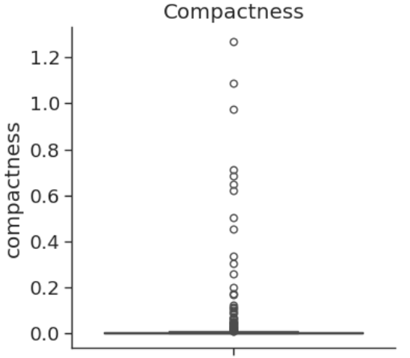



Metacell formation :
A few metrics
30

Slide 31

Metacell formation
31

Slide 32
Differential expression in each cell type
DESeq2
Data X_test
Metacell count matrix creation with X_test
Differential expression of genes
[1.]
Gene marker analysis
Metacell creation using SEACell
SEACell
Integrated data with X_train
Normalised data with X_train
Annotated data
Normalization :
- log1 transform
32
1.Neufeld, A., Gao, L. L., Popp, J., Battle, A. & Witten, D. Inference after latent variable estimation for single-cell RNA sequencing data. Biostatistics 25, 270–287 (2023)

Slide 33


Differential expression in each cell type
IFI27
IFI27
IFI6
PLAUR
ISG15
IFIT1
IFI44L
B3GALT5
GABRE
TNFRSF10D
33

Slide 34


Differential expression in each cell type
IFI6
IFI27
IFI6
IFI27
OAS1
ISG15
SOCS3
OAS1
MX1
IFIT1
DUSP6
CELF2
34

Slide 35


Differential expression in each cell type
IFI27
IFI27
IFI6
MX1
IFI44L
OAS1
IFI6
IFIT1
ISG15
IFI44L
MYRIP
CMTM4
APELA
35

Slide 36


Differential expression in each cell type
IFI6
IFI6
IFIT1
IFI27
IFI27
ISG15
IFI44L
IFIT3
IFIT1
IFI44L
36
36

Slide 37


Differential expression in each cell type
IFI6
IFI27
MX1
IFI6
ISG15
IFIT1
MX2
KRT15
IFI44L
IFIT1
EDIL3
CMTM4
LUM
37

Slide 38


Differential expression in each cell type
IFI6
IFIT1
ISG15
BST2
IFI27
IFIT1
SL9A9
38

Slide 39

sc Proteomic
39

Slide 40


sc Proteomic: Choices
Logic gate Xor :
(A or B) and NOT (A and B)
A
B
40
Peptides
Imputations
Integration
Normalisation
Proteins
No Imputations
No Integration

Slide 41

"State-of-the-art" : ScoPEC workflow
Proteins
Peptides
41

Slide 42

sc Proteomic: Choices
Logic gate Xor :
(A or B) and NOT (A and B)
A
B
42
Linked problem
Peptides
Imputations
Integration
Normalisation
Proteins
No Imputations
No Integration

Slide 43


Imputation or no imputation
Several algorithms are available for data imputation, either for the proteins or the peptides :
FastMNN
MissForest
KNN
None were applied to avoid introducing biais or distorting the original data. The issue was observed in a later stage.
Imputated data with MissForest
43
Peptides
Imputations
Integration
Normalisation
Proteins
No Imputations
No Integration

Slide 44



Review of the data
List of anndata frames :
- Anndata1 : 145 x 5701
- Anndata2 : 138 x 4142
- Anndata3 : 133 x 2969
- Anndata4 : 139 x 3223
- Anndata5 : 108 x 3212
- Anndata6 : 140 x 4385
List of NaN in anndata frames :
Key graphs:
Raw counts
44

Slide 45
Dimensionality reduction
Mock J3
Mock J6
The excluded genes are erased from all the datasets.
Reasons :
Technical variation between samples
Degeneration due to aging cells
2 636
3 065
158
45

Slide 46


List of anndata frames :
- Anndata1 : 145 x 3065
- Anndata2 : 138 x 3113
- Anndata3 : 133 x 2402
- Anndata4 : 139 x 3065
- Anndata5 : 108 x 2837
- Anndata6 : 140 x 2926
Dimensionality reduction
Raw counts ; mockJ3 ∩ mockJ6
46

Slide 47


Normalisation
Raw
47
Log1p normalisation
Pearson residue normalisation

Slide 48

Normalisation
Logic gate Xor :
(A or B) and NOT (A and B)
A
B
48
Peptides
Imputations
Integration
Pearson
residue
Proteins
No Imputations
No Integration

Slide 49



Integration or no integration
There are many algorithm available for integrating data, mostly used for sc RNA seq. The most well-known include :
Harmony
scVI
Scanorama
ComBat
Harmony and scVI did not perform well on the data. Based on a study of Gong, Y. et al.[1], Scanorama and ComBat were identified as the most effective methods for integrate scP data. Scanorama was perceived as better, so it was chosen for this analysis.
Unintegrated data
Integrated data with Scanorama
49
1.Gong, Y. et al. Benchmark of Data Integration in Single-Cell Proteomics. Anal. Chem. 97, 1254–1263 (2025).
Peptides
Imputations
Integration
Pearson
residue
Proteins
No Imputations
No Integration

Slide 50
Pipeline for sc Proteomic
∩
Mock_J3
Mock_J6
Dimensionality reduction
Proteins Data
Scaled protein data
Normalised data
Integrated data
Annotation
Normalisation :
- Pearson
Scanorama
50

Slide 51


Annotation using Mock data
UMAP Mock j3 & J6 overcluster
UMAP Mock j3 & J6 ID
51

Slide 52





Annotation using Mock data
52

Slide 53


Annotation using Mock data
Basal
Superbasal
Ciliated
Secretory
UMAP Mock j3 & J6 2D of the metacluter
UMAP Mock j3 & J6 3D of the cell types
53

Slide 54


Annotation using Mock data
Global UMAP with cell types from Mock analysis
Global UMAP with overcluster
54

Slide 55


Annotation
Exemple :
55
1.Ruiz García, S. et al. Novel dynamics of human mucociliary differentiation revealed by single-cell RNA sequencing of nasal epithelial cultures. Development 146, dev177428 (2019).

Slide 56

Annotation
KIF3A-/MUC5B+
~KIF3A+/MUC5B+
KIF3A+/MUC5B-
KIF3A+/MUC1+/BP1B1+
56

Slide 57

New markers for the annotation
Inf J3
Basal cells
Ciliated cells
Secretory cells
57

Slide 58

Cell type conundrum
1.Davis, J. D. & Wypych, T. P. Cellular and functional heterogeneity of the airway epithelium. Mucosal Immunology 14, 978–990 (2021). Modified by Yohan Beaumatin

Slide 59

New markers for the annotation:
Screening of the clusters
Inf J3
Screening criterias:
30% or more cells
Expression of 10+
All the clusters selected
59

Slide 60

New markers for the annotation
Inf J3
60

Slide 61
Thank you
61

